Slide 1

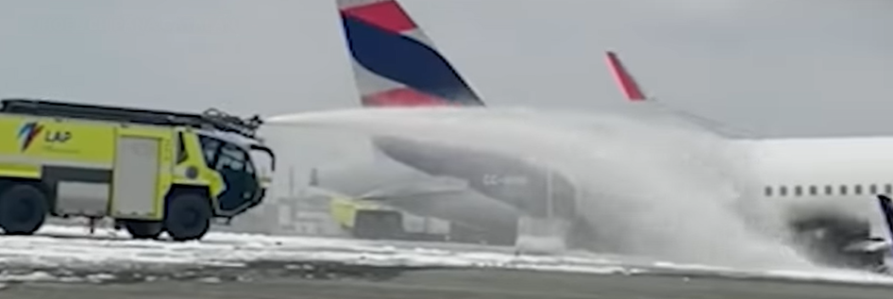
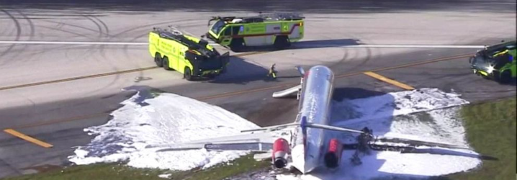



Transition des AFFF vers des NFF*non fluorés
NFF-3B – ARFF Emergency Response
August 2025
FOAM MASTERCLASS – Thailand 2025
David Ramsay – Regional Sales Manager Foam and Foam Hardware - APAC

Slide 2
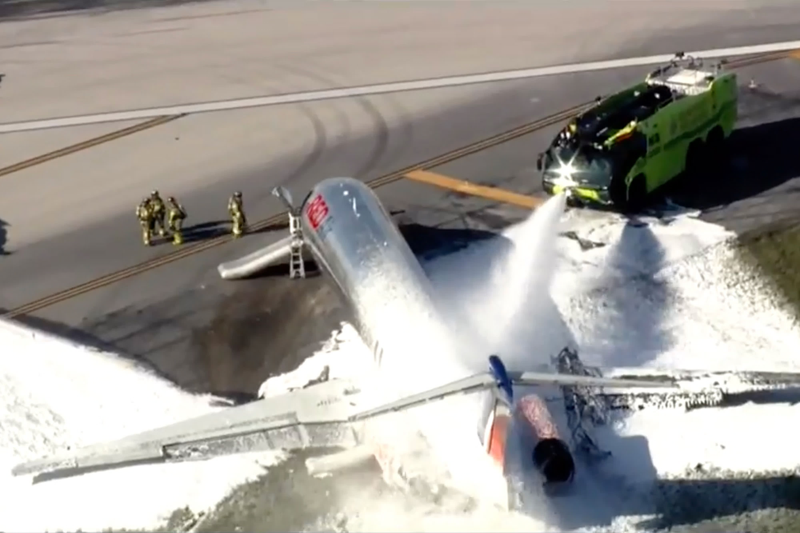
Agenda overview
Aviation Foam Regulations
ICAO standards
NFF-3B overview
  Physical properties
  Dry Chemical compatibility
  Environmental data
  Competitive landscape
Q&A

Slide 3

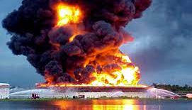



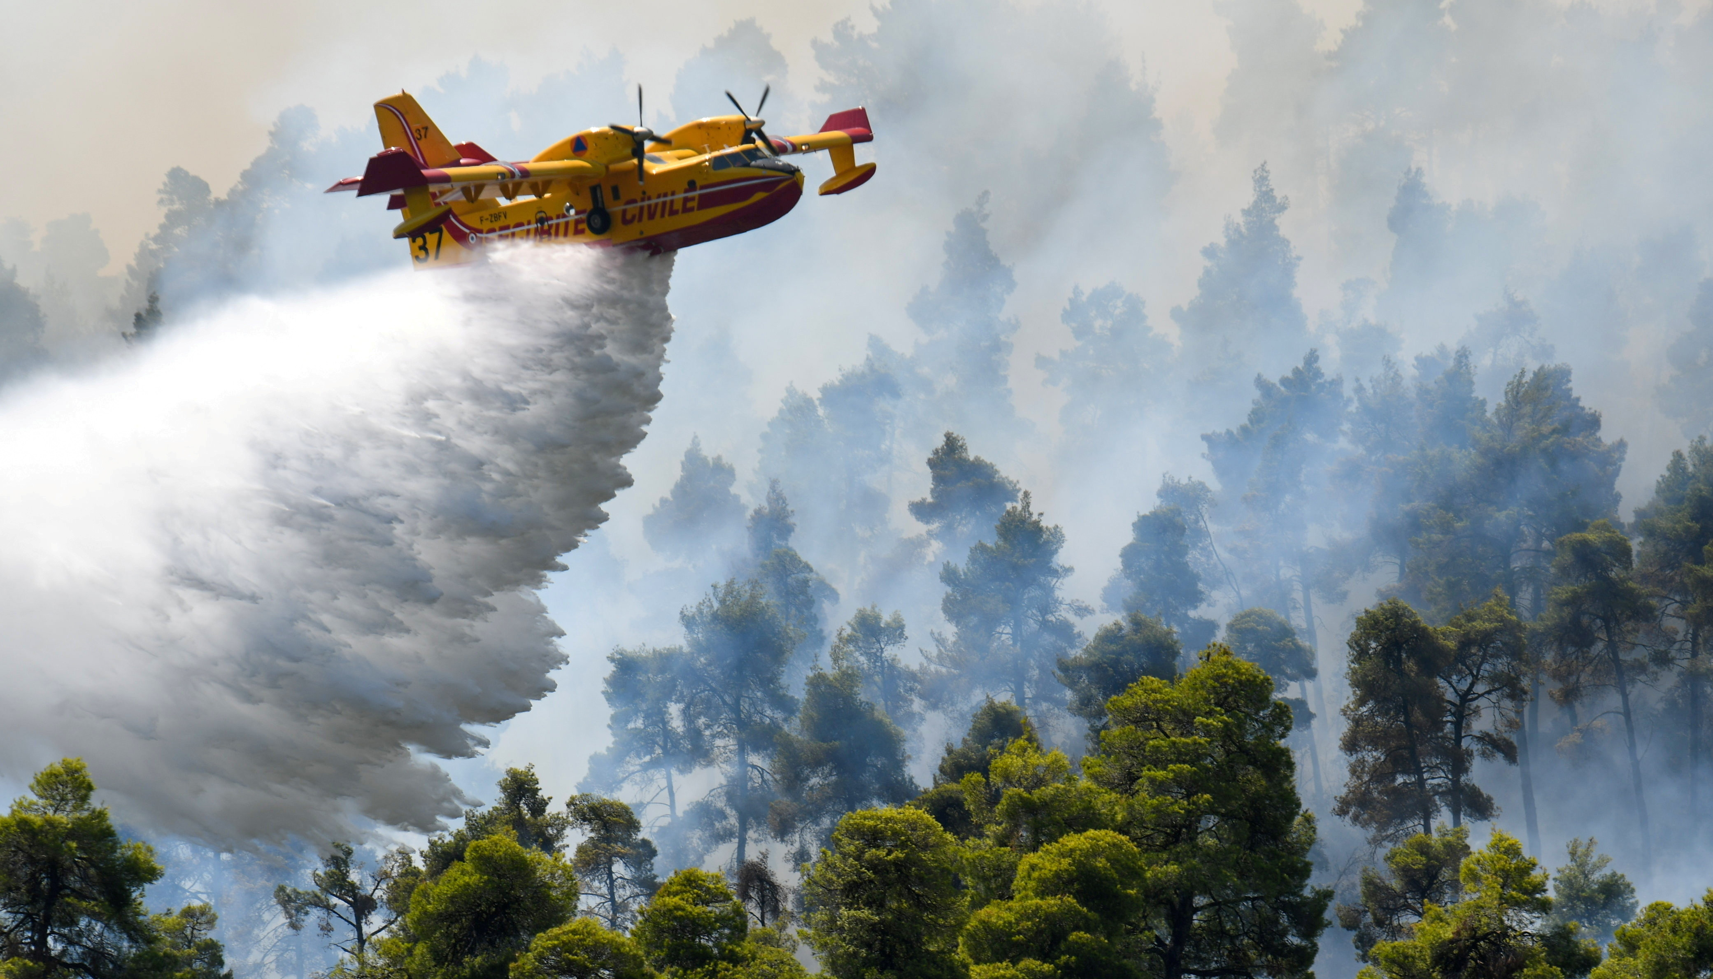

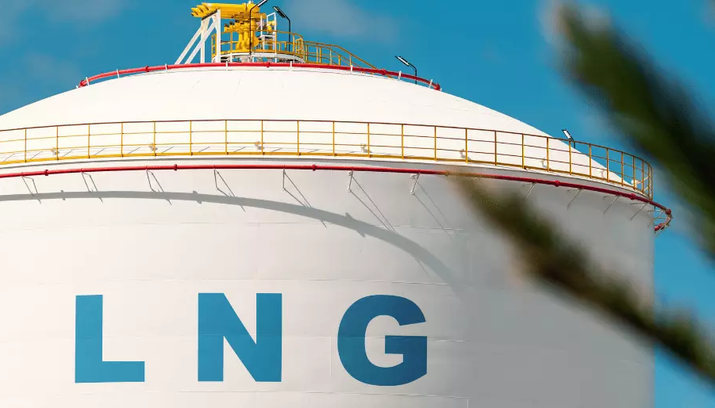

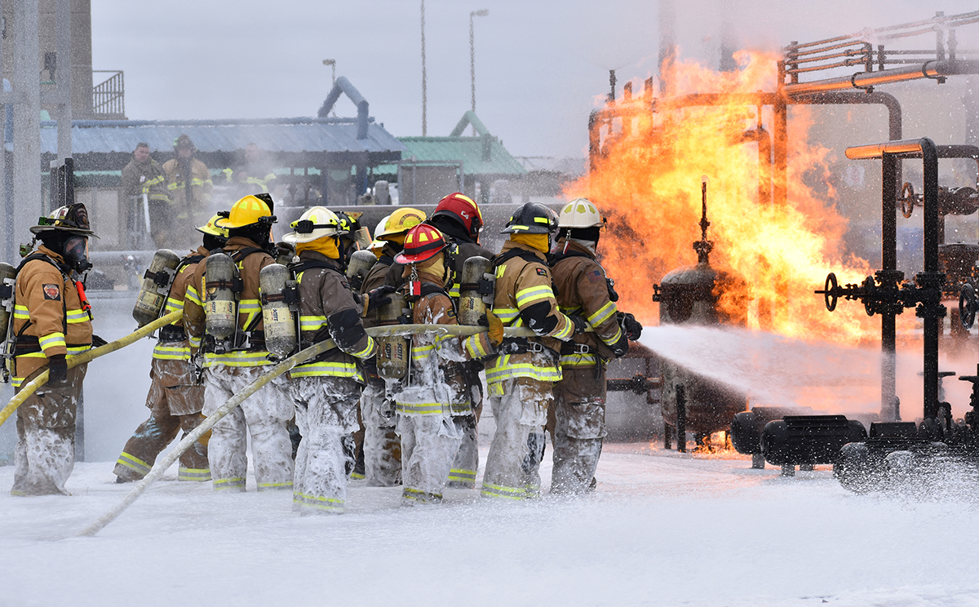
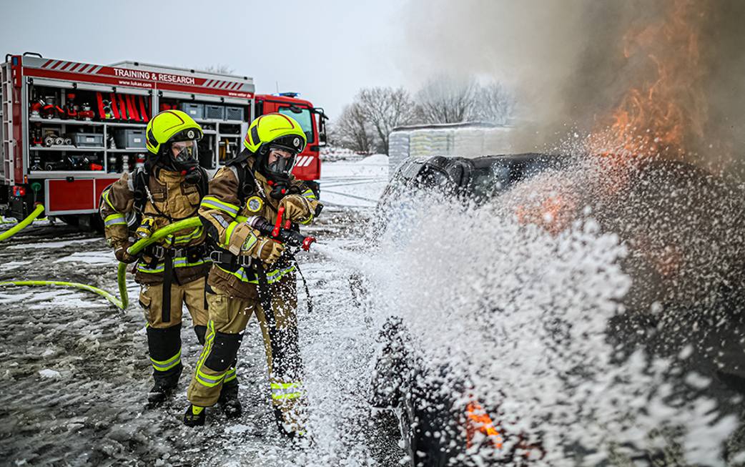
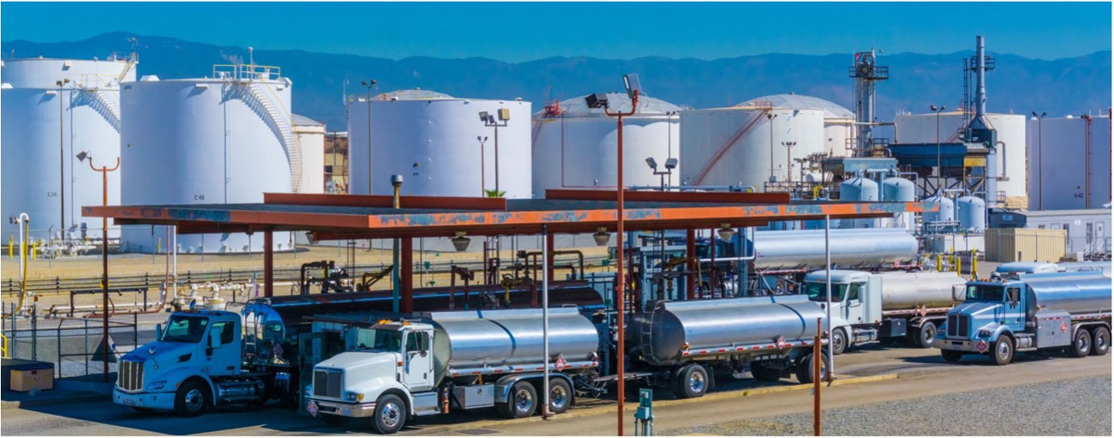
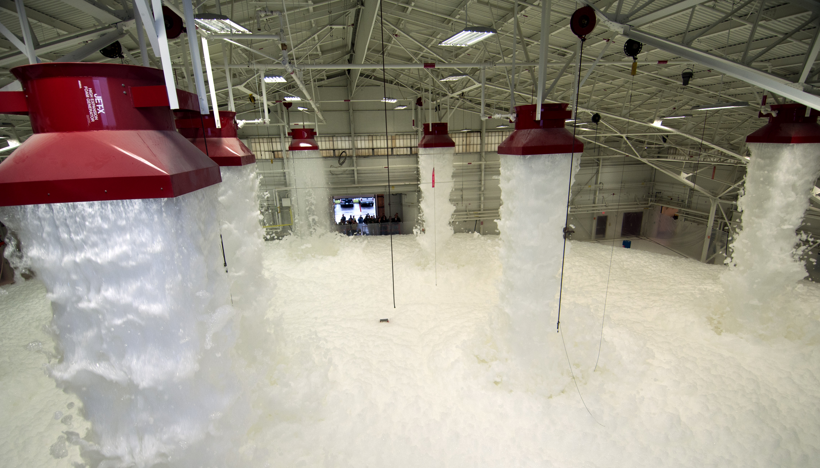
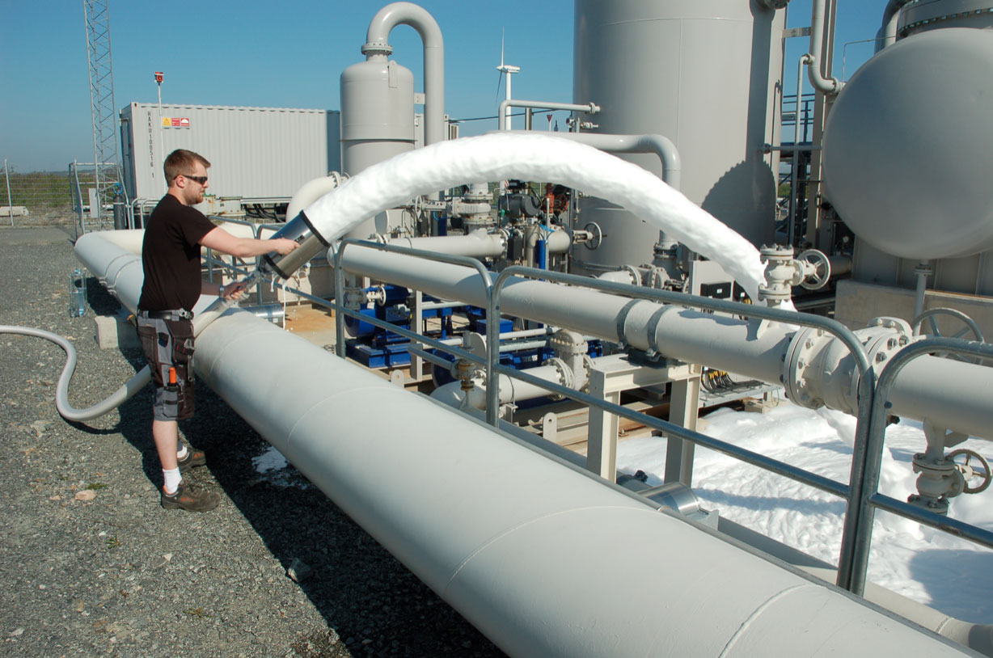



Johnson Controls Non-Fluorinated Foam Industry offering
Large Tank Fire Response
THUNDERSTORM WNF33A 3x3
THUNDERSTORM WNF33A 1x3
Aviation
ANSUL JET-X 2%
ANSUL JET-X 2 ¾%
ANSUL NFF 3x3 UL201
ANSUL NFF-331
ANSUL 3% SFFF ICAO B NFF-3B
ANSUL 3% MIL-SPEC SFFF Pending
CHEMGUARD C2
CHEMGUARD NFF-331
CHEMGUARD NFF 3x3 UL201
CG 3% MIL-SPEC SFFF Pending
SKUM METEOR X 2%
SKUM HOTFOAM 2%
SKUM NFF-331
SKUM NFF 3x3 UL201
SKUM 3% SFFF ICAO B NFF-3B
Marine
SKUM NFF 3x3 UL201
SKUM HOTFOAM 2%
SKUM PLUREX M
ANSUL T-STORM NFF 3x3 UL201
Civil Defense & Municipal Fire Brigades
ANSUL NFF 3x3 UL201
ANSUL T-STORM NFF 3x3 UL201
CHEMGUARD NFF 3x3 UL201
SKUM NFF 3x3 UL201
SKUM PLUREX M
SKUM PLUREX MD3
Wildfires & Class A Fires
ANSUL SILV-EX PLUS
ANSUL MUNICIPAL A
CHEMGUARD DIRECTATTACK
CHEMGUARD CHEMATTACK
CHEMGUARD CLASS A PLUS
CHEMGUARD EXTREME
SKUM SILV-EX G
LNG Application
ANSUL JET-X 2%
ANSUL JET-X 2 ¾%
Enhanced Foam Sprinkler Systems
ANSUL NFF-331
CHEMGUARD NFF-331
SKUM NFF-331
Training Foams
CHEMGUARD CTF1
ANSUL TRAINING FOAM
SKUM METEOR TRAINING FOAM
CAFS Application
ANSUL MUNICIPAL A
CHEMGUARD EXTREME
Fixed Foam Systems
ANSUL NFF-331
ANSUL NFF 3x3 UL201
ANSUL T-STORM NFF 3x3 UL201
CHEMGUARD NFF-331
CHEMGUARD NFF 3x3 UL201
SKUM NFF-331
SKUM NFF 3x3 UL201
High Expansion Foams
ANSUL JET-X 2%
ANSUL JET-X 2 ¾%
CHEMGUARD C2
CHEMGUARD C2S
CHEMGUARD EXTRA
SKUM METEOR X 2%
SKUM HOTFOAM 2%
Vapor Suppression
TARGET 7

Slide 4

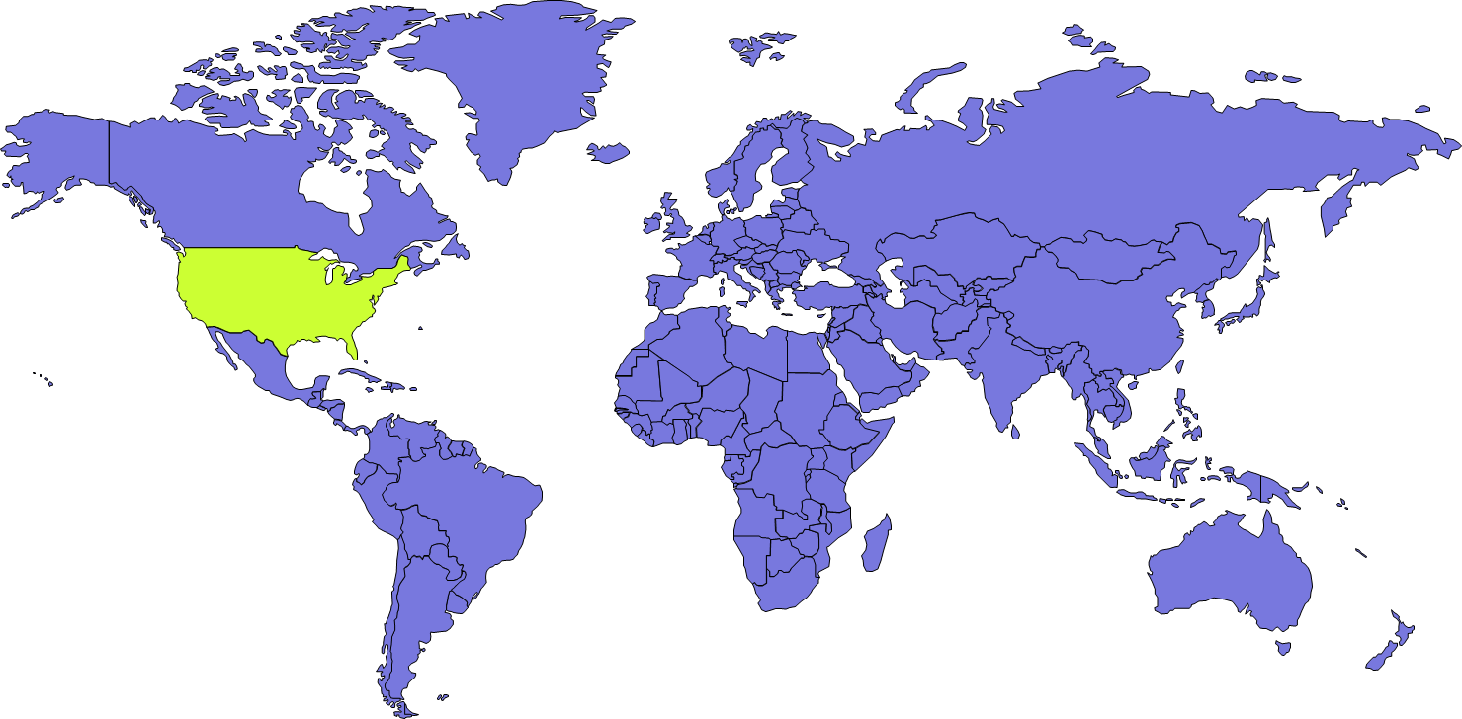


Aviation Foam Regulations*
Risk | Standard | Listings | Region | Typical Foam Application
Aircraft | NFPA 409 | UL or FM | Global | Fixed System Design
Aircraft | EN13565-2 | EN1568 | Europe | Fixed System Design
Aircraft Military | ETL – UFC 4-211-01 | UL or FM | US | Fixed System Design
Helicopter | NFPA 418 | UL or FM | Global | Fixed System Design
Helicopter | CAP 437 | ICAO B-C | Global | Fixed System Design Offshore
Helicopter | ICAO Doc 9261 | ICAO B | Global | Fixed & Manual
Airports ARFFs | ICAO Doc 9137 | ICAO A-B-C | Global | Emergency Response
Airports ARFFs | MIL-SPEC / QPL | MIL-PRF-32725 | US | Emergency Response
* Many more country specific Aviation Safety regulation
US Army & FAA [Federal Aviation Authority] imposing QPL Listed foams [Mil-Spec]
International Civil Aviation Organization

Slide 5
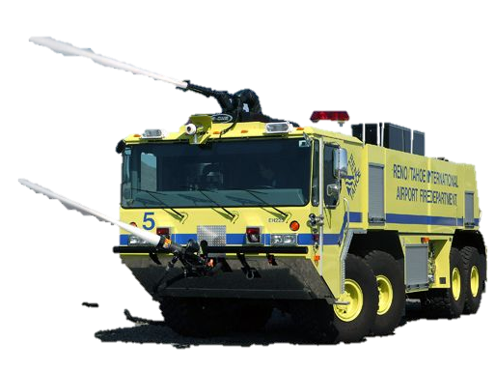
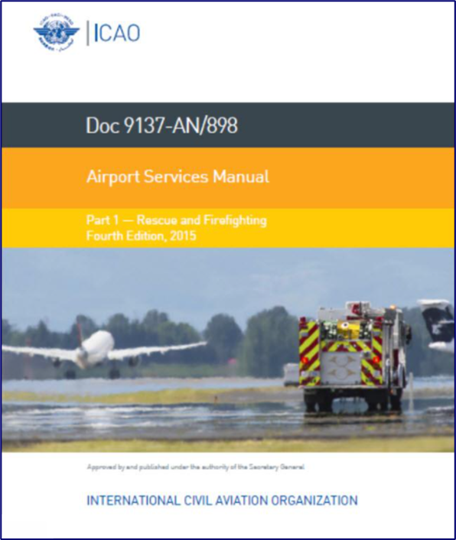
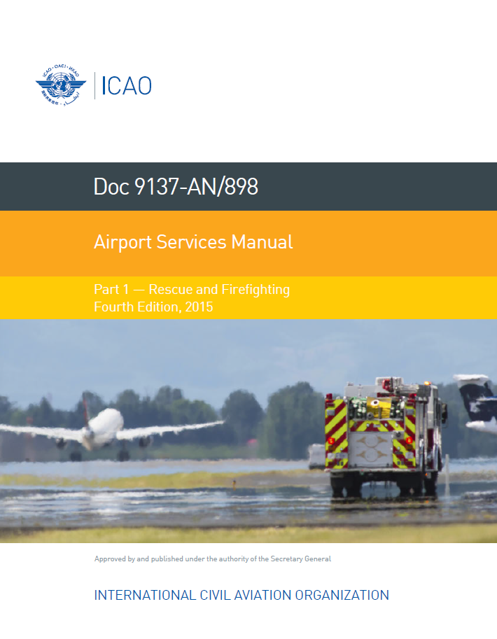
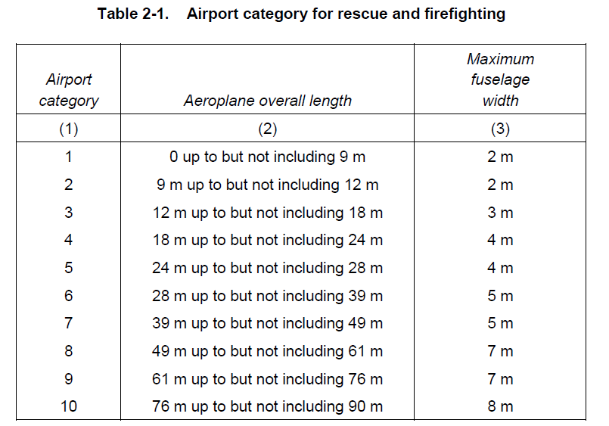
ICAO Doc 9137 Airport Manual Regulation
Fire Fighting foams are regulated on Airport use by the ICAO standard
Global Regulation :
ICAO Doc 9137 ‘Airport Services Manual Part 1 – Rescue and Firefighting’ Fourth Edition, 2015
Airports classified in 10 categories based on the dimensions of landing Airplanes.
Remember this Acronym : ARFF
ARFF stands for Aircraft Rescue & Fire Fighting
This is where ICAO foams are imposed
Notes:
Fire Fighting foams are regulated on Airport use by the ICAO standard
Global regulation :
ICAO Doc 9137 ‘Airport services manual Part 1 – Rescue and Firefighting Edition 2015
Airports are classified in 10 categories based on the dimensions of the landing aircraft.
The relevant category has implications further on in the standard for fire protection equipment
The acronym ARFF – stands for Airport Rescue & Fire Fighting

Slide 6
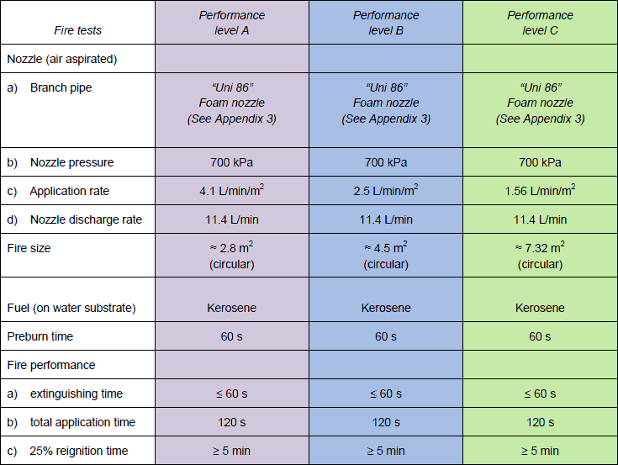
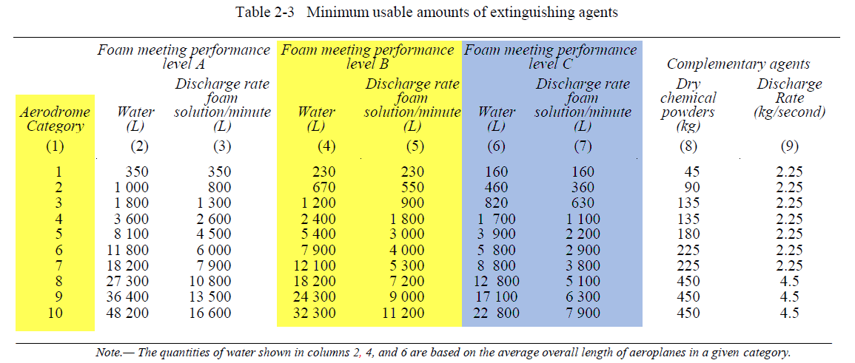
ICAO Doc 9137 Manual
Fire Fighting foams Crash trucks are regulated on Airport use by the ICAO standard
Airport category drives Extinguishing Agent [Foam & DCP] volumes and stocks requirements.
ICAO Standard is classifying foams into 3
performance category A-B-C (C=Highest)
A typically applicable for Airfields … A category not used anymore
B & C for National and International Airports
Notes:
Fire fighting foams Crash trucks are regulated on Airport use by the ICOA standard.
Airport category drives Extinguishing Agent (both Foam and Dry Chemical powder) volumes and stocks replacement.
ICAO standard is classifying foams into 3 performance category A-B-C ( C being the highest). We don’t see ICAO-A used anymore, ICAO-B still the most common globally, but starting to see more interest in C.
Above table gives the performance requirements based on the different levels, with the prescribed nozzle pressures, application rates, and pan fire size. Extinguishing time is to be less than 60 seconds
Table 2-3 gives the minimum amounts of extinguishing agents, based on the airport category required to obtain a one minute control time in the practical critical area, and the quantity of extinguishing agents which are required for continued control of the fire thereafter.
80% of the market is ICAO-B classification

Slide 7
ICAO Regulations Crash Rescue Fire Trucks [ARFFs]
2.3.4 The quantity of foam concentrate separately provided on vehicles for foam production should be
in proportion to the quantity of water provided and the foam concentrate selected. The amount of foam
concentrate should be sufficient to supply at least two full loads of such quantity of water
2.3.5 The amounts of water specified for foam production are predicated on an application rate of
8.2 L/min/m² for a foam meeting performance level A
5.5 L/min/m² for a foam meeting performance level B
3.75L/min/m² for a foam meeting performance level C
These application rates are considered to be the minimum rates at which control can be achieved within one minute.
Table 2-4. Maximum qty of extinguishing agent based on largest airplane dimension
AIRPORT CATEGORY | Water Stock needed for max Airplane size [Litres] |  | Minimum number of vehicles RFF
 | Foam Level B | Foam Level C
1 | 462 | 315 | 1
2 | 782 | 533 | 1
3 | 1459 | 995 | 1
4 | 2920 | 1991 | 1
5 | 6109 | 4165 | 1
6 | 10010 | 6825 | 2
7 | 14409 | 9824 | 2
8 | 20855 | 14219 | 3
9 | 27859 | 18995 | 3
10 | 36382 | 24806 | 3
2.6 SUPPLY AND STORAGE OF EXTINGUISHING AGENTS
2.6.1 The quantities of the various extinguishing agents to be provided in the RFF vehicles should be in accordance with the airport category and Table 2-3. A reserve supply of foam concentrate equivalent to 200 per cent of the quantities of these agents identified in Table 2-3 should be maintained on the airport for vehicle replenishment
purposes.
Notes:
The ICAO standard dictates the different minimum application rates 8.2 L/min/m2 for Level A, 5.5 for B and 3.75 for level C
And the maximum qty of extinguishing agent based on the largest aircraft dimension
The standard requires a reserve supply of foam concentrate equivalent to 200% of the quantities identified in Teable2-3
(Previous slide)

Slide 8
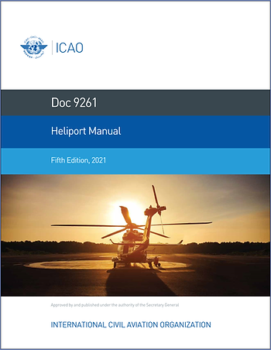
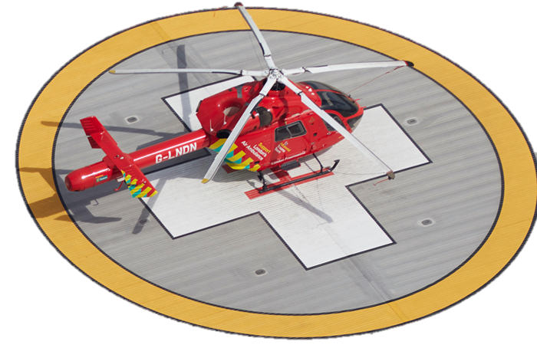
ICAO Doc 9261 Heliport Manual Regulation
Fire Fighting foams system design for Heliports are regulated by many standards (ICAO, CAP437, NFPA418, …)
Global Regulation :
ICAO Doc 9261 ‘Heliport Manual’
Table 6.4 Calculation of critical area and amounts of water needed for foam production using ICAO B level foam
 |  |  | Helicopter fire fighting category
 |  |  | H1 | H2 | H3
Critical area (m²) |  |  | 47 | 87 | 144
Application rate (L/min/m²) |  |  | 5.5 | 5.5 | 5.5
Discharge rate - foam solution (L/min) |  |  | 250 | 500 | 800
Water needed for foam production
 | Surface level heliport (L) | Surface level heliport (L) | 500 | 1000 | 1600
 | Elevated heliport (L) | Elevated heliport (L) | 2500 | 5000 | 8000
 | Implicit application duration (not in the standard) | Implicit application duration (not in the standard)
 | Surface level heliport (minutes) | Surface level heliport (minutes) | 2 | 2 | 2
 | Elevated heliport (minutes) | Elevated heliport (minutes) | 10 | 10 | 10
Table 6.1 Heliport fire fighting category
Category | Helicopter over-all length ¹
H1 | up to but not including 15 m
H2 | from 15m up to but not including 24m
H3 | from 24m up to but not including 35m
1. Helicopter length, including the tail boom and the rotors
NFF-3B would not be suitable for systems using Sea Water (e.g. CAP437)
Notes:
The ICAO standard also covers the Heliport use under the document 9261
Fire Fighting foams system design for heliports are regulated by many standards ICAO, CAP437, NFPA 18…
ICAO Doc 9261 ‘Heliport Manual’ prescribes the minimum application rates based on the Aircraft overall length
Depending on the category H1 H2 H3, table 6.4 gives us the performance requirements we need to achieve
Critical Area, Application rate in LPM/min/M2
Discharge rate for the foam solution and the amount of water required
International Airports for ARFF do not use Sea Water – So should not be an issue

Slide 9
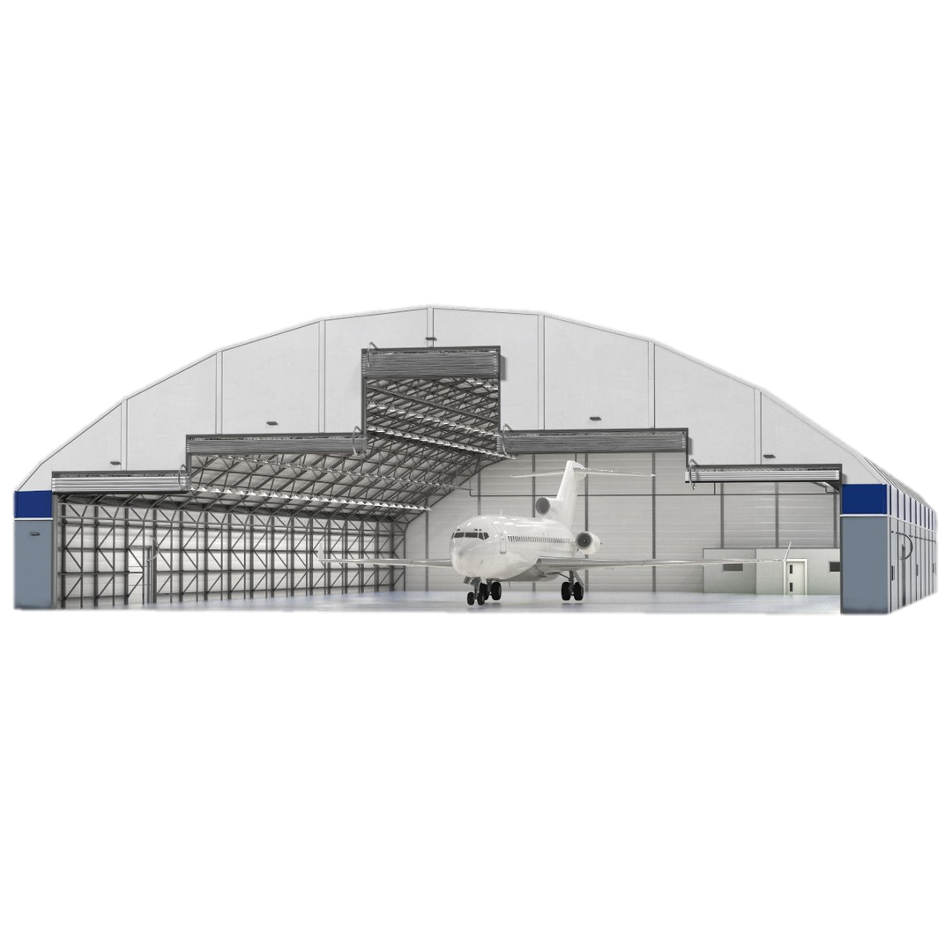


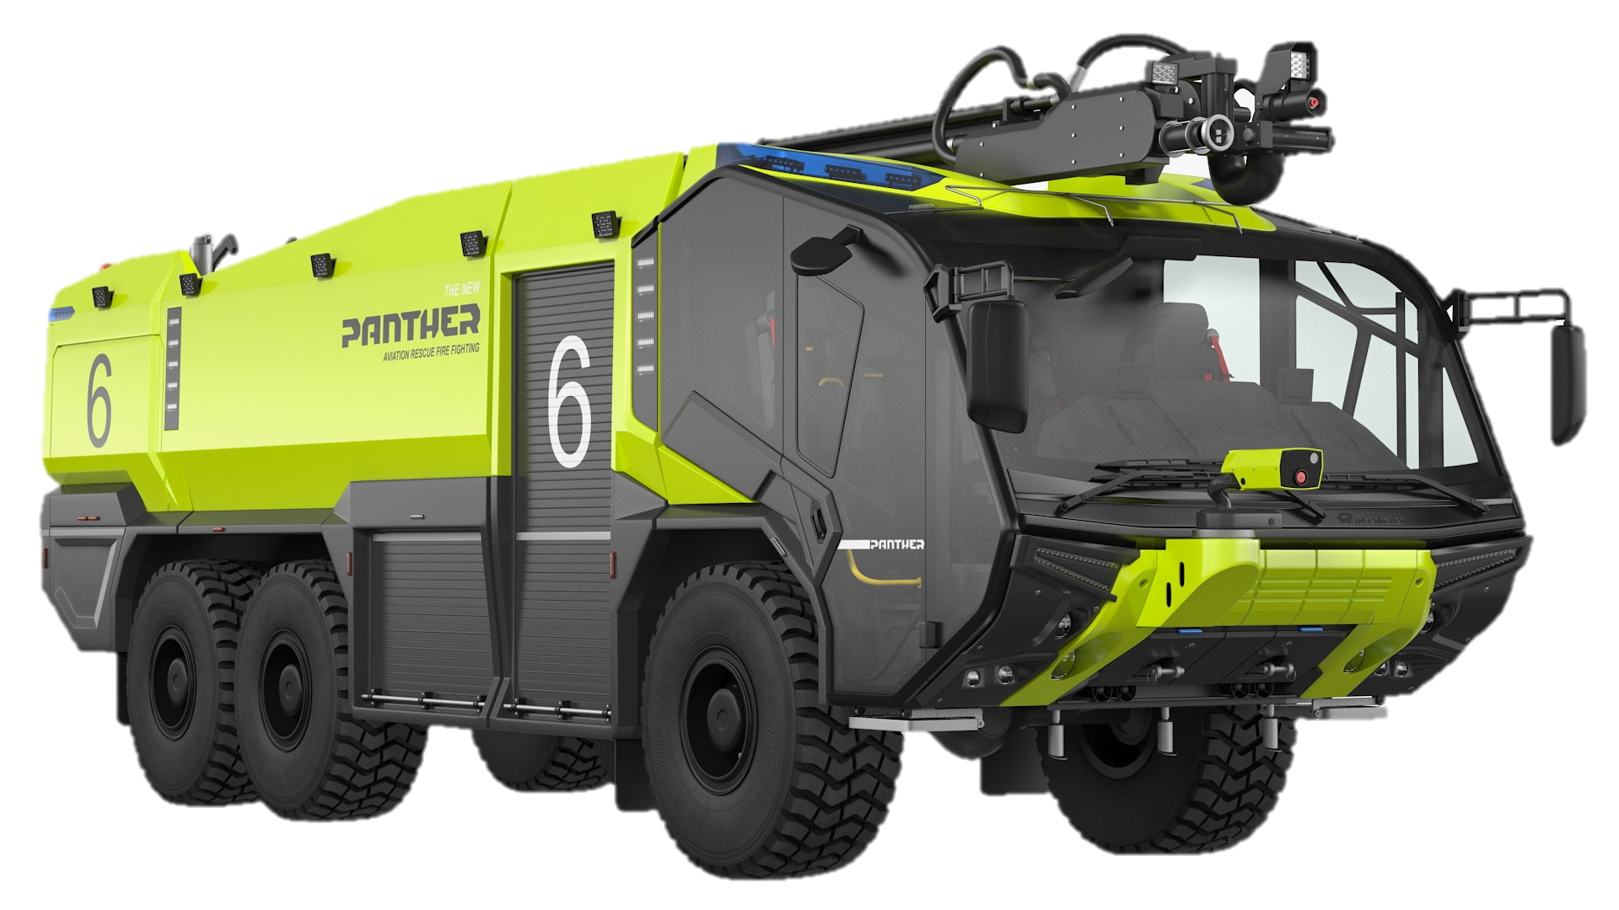
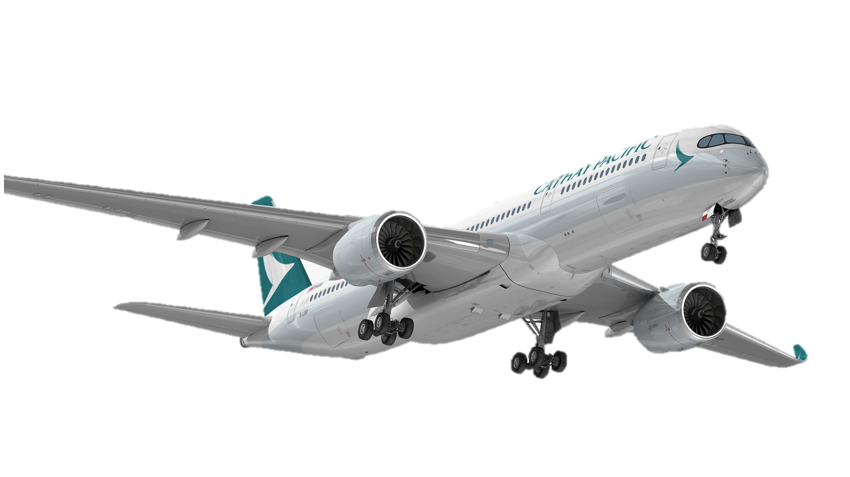
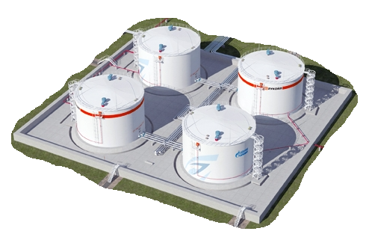
AIRPORT ENVIRONMENT RELATED TO FUEL FIRE RISKS
Fire Station 2
Aircraft Maintenance Hangars (Airlines property)
Fire Station 3
Runways
Each Fire Stations :
3 Crash tenders (ARFFs)
7000 Ltr of Foam
2000 Kg Powder
Fire Station 1
Fuel depot
(Oil co. property)
Schiphol Airport example
Notes:
For a typical airport we have several risks that we supply systems for
Hangar protection with overhead sprinklers or deluge systems, typically foam based. Foam systems to the underwing.
The fuel farm with foam systems to the tank for in tank surface application, protection to the surrounding bunds
The fire station itself, the terminal, systems that you would see for a commercial building
But topic today is more on the foam agent used on the Crash Rescue Vehicles
Schiphol Airport in Amsterdam

Slide 10

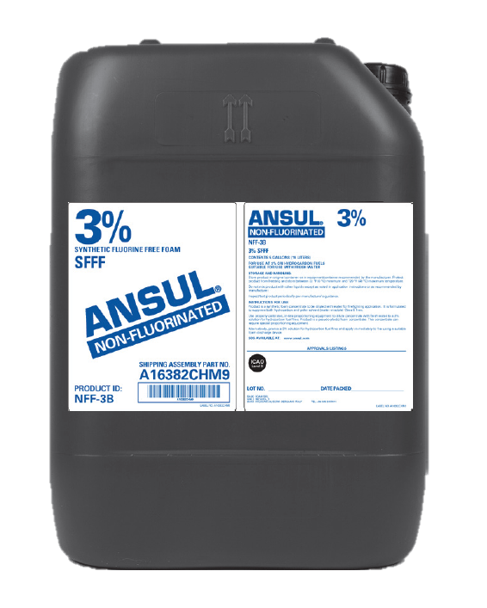

NFF-3B
High Performance SFFF 3% Non-Fluorinated Foam specifically designed for ARFFs fire trucks Application per
ICAO regulation
Notes:
Lets have a closer look at our ICAO-B foam product

Slide 11
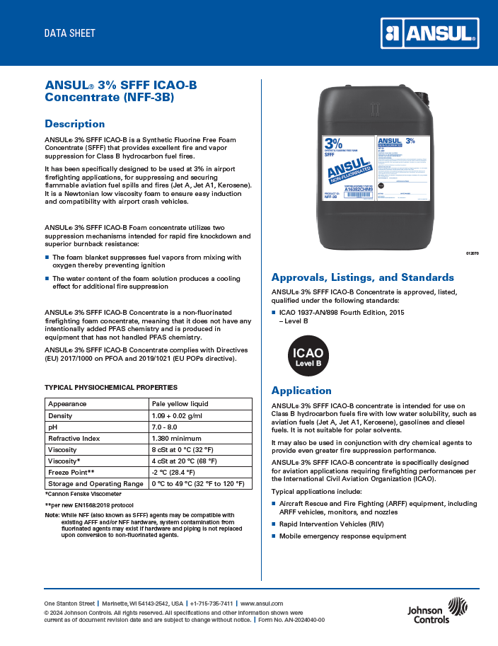
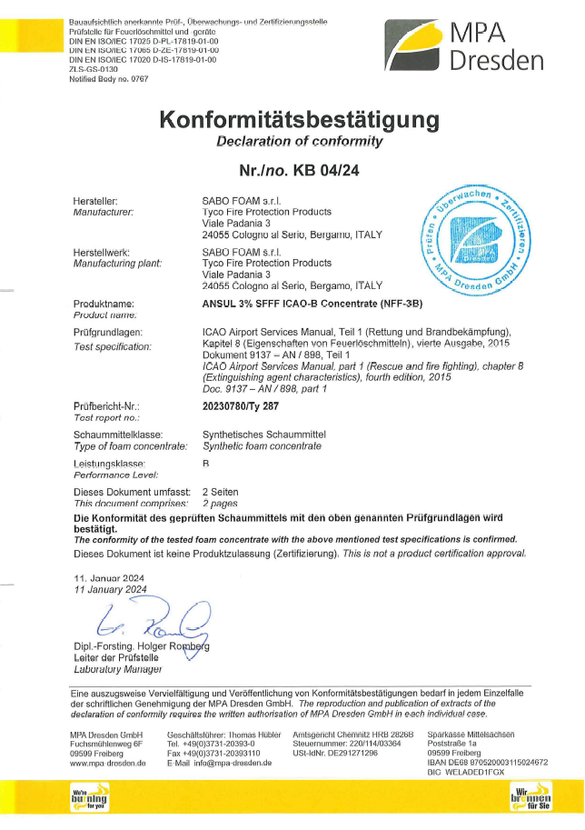

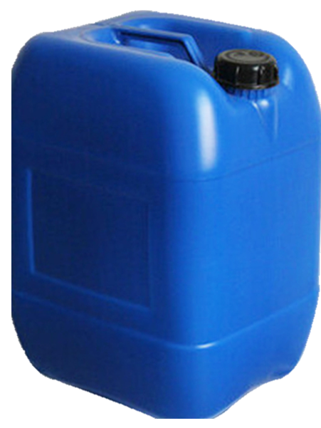
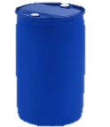
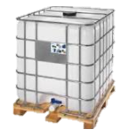
ANSUL 3% SFFF ICAO-B
Product summary slide
NFF-3B
3%
Key applications
Airport Fire trucks (ARFF)
Military Air Forces
Heliports (Helidecks)
Key features
Non-fluorinated F3 / SFFF 3%
ICAO level B tested (MPA )
Viscosity : Newtonian _ 4 cSt @ 20°C
Dry Chemical Powder compatible
Foam Expansion : Suitable for both Air-Aspirated and Non-Air-Aspirated foam discharge devices
Environment : Greenscreen certification
Freeze Protected -2°C
 | 20 Ltr | A16382CHM9
 | 200 Ltr | A16382CHMA
 | 1000 Ltr | A16382CHMB
Notes:
Key applications are
Airport Fire Trucks (ARFF
Military Air Forces
Heliports or Helidecks
Some of the Key Features
PFAS free
Independently certified to the ICAO standard by MPA
Newtonian product
Dry Chem powder compatible with foam
Green Screen certified
Product come in the 20 Litre, 200 Litre and 1000 Litre Totes

Slide 12
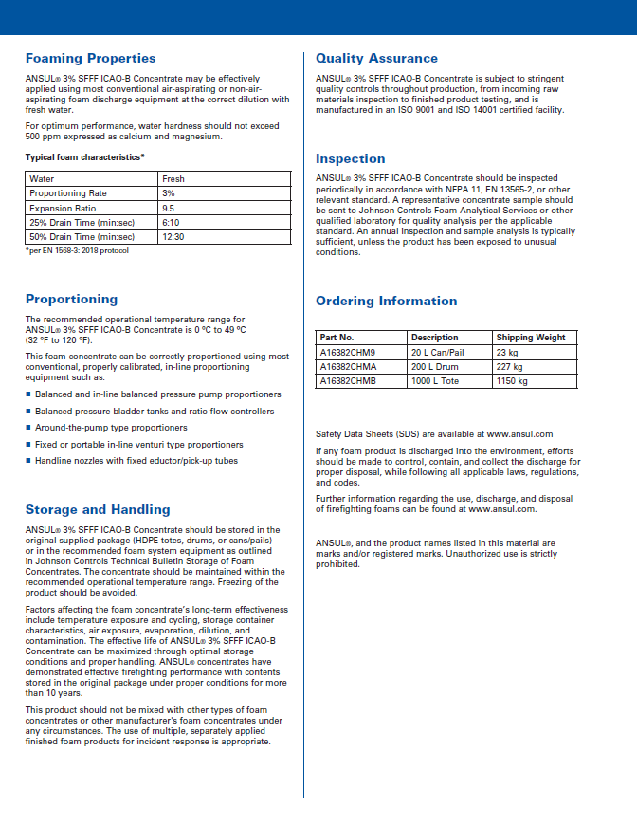

ANSUL 3% SFFF ICAO-B
Notes:
The Technical data sheet gives the
Description
Physiochemical properties
Approval listings
Applications
Foam properties
Storage and handling guidelines

Slide 13
ANSUL 3% SFFF ICAO-B
Notes:
The Technical data sheet gives the
Description
Physiochemical properties
Approval listings
Applications
Foam properties
Storage and handling guidelines

Slide 14


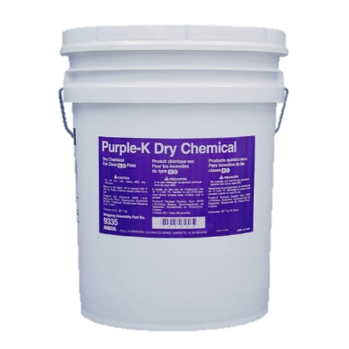
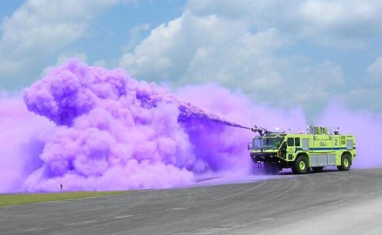
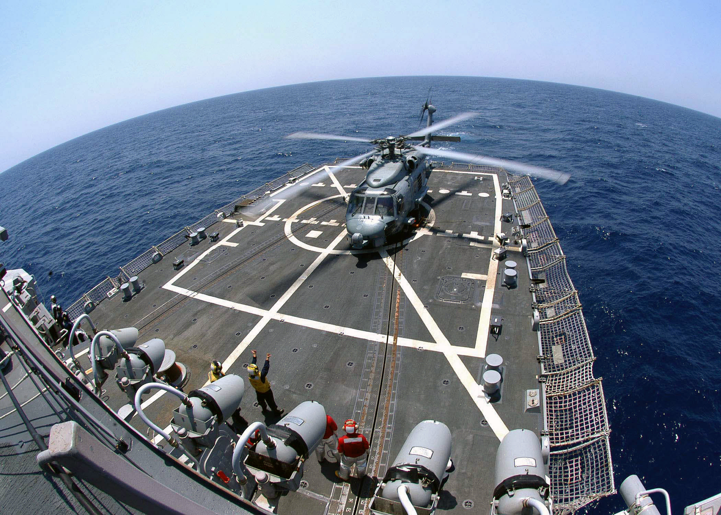

Dry Chemical Powder Compatibility
Dry Chem Powder Compatibility with Foam is typically internationally evaluated following MIL-SPEC test method
Status of Non-Fluorinated Foam manufacturers about Dry Chemical Powder Compatibility into Technical Data Sheets [TDS] :
No mention = Assume NOT compatible
Compatibility Verified
SKUM 3% SFFF ICAO-B
ANSUL 3% SFFF ICAO-B
Not Compatible
  Majority of foam manufacturers TDS not addressing Dry Chemical Powder compatibility with their Non-Fluorinated Aviation Foams
Notes:
Dry Chemical powder is a key element of fire fighting in conjunction with foam, Foam works well on surface application, for a 3 dimensional fire we need the assistance of Dry chem powder, so it’s key that the foam is compatible with the powder.
Dry Chemical Powder compatibility with Foam is typically internationally evaluated following MIL-SPEC test method.
If we look at the status of Dry Chemical Powder compatibility and refer to the Technical data sheets, we find that most Foam manufactures no longer address compatibility, if there is no mention, we need to assume its not compatible. A lot of the competitor products dropped off the mention of compatibility when they moved from PFAS to NFF foams.
Our foam has been tested and confirmed it is compatible for use with Dry Chemical Powder.

Slide 15
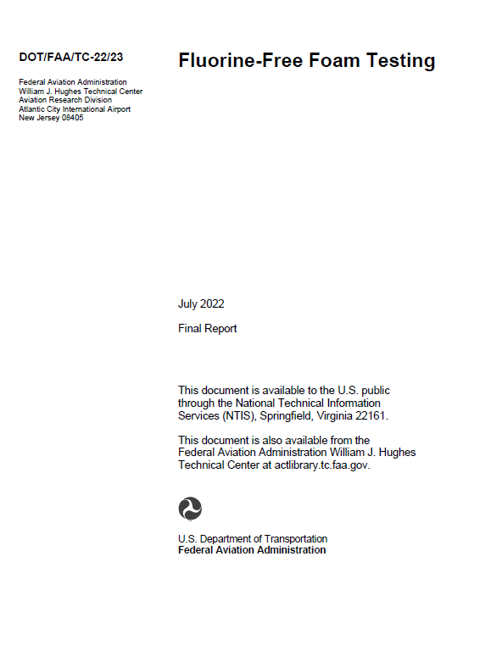


Dry Chemical Powder Compatibility
Foam type | Manufacturer | Product | ICAO Level | Dry Chem compatibility reported conclusion
SFFF / F3 | FOMTEC | ENVIRO USP | B | During the compatibility test, dry chemical appeared to quickly break down the foam blanket,
SFFF / F3 | BIO-EX | ECOPOL A | B | The foam agent did exhibit an adverse reaction to the application of dry chemical. While it was not an instantaneous degradation, the foam blanket did begin to break down
SFFF / F3 | BIO-EX | ECOPOL A+ | B | The dry chemical compatibility did show an adverse reaction to the application of the dry chemical. This is demonstrated by the reduction in burnback time to 2:57.
SFFF / F3 | BIO-EX | ECOPOL F3 HC | N/A | Dry chemical application caused an instant breakdown of the foam blanket, leading to immediate reignition of the pan once the burnback pan was inserted.
SFFF / F3 | SOLBERG | RF3 | B + C | The foam agent did exhibit an adverse reaction to the dry chemical application as shown by the reduced burnback time of 5:28.
SFFF / F3 | SOLBERG | AVIGARD 3B | B | Did exhibit an adverse reaction to the application of dry chemical, which more than halved the burnback time
SFFF / F3 | NATIONAL FOAM | AVIO F3 GREEN KHC | C | As with other FFFs, addition of dry chemical caused a decrease in burnback time
AFFF | CHEMGUARD | C3IC1 | C | Did not show any adverse effects from the application of dry chemical
FAA Public report
Fluorine Free Foam test campaign
Powder / Foam Compatibility issues SFFFs vs AFFFs ?
FAA
NFF report testing
July 2022 Extract*
ICAO Position
2.2.3 The complementary extinguishing agent should be:
a) dry chemical powders (classes B and C powders); or
b) other extinguishing agents with at least the same firefighting capability.
When selecting dry chemical powder for use with foam, care must be exercised to ensure compatibility.
Notes:
If we look at Dry Chemical compatibility. The FAA did a very detailed test on Non-Fluorinated foams with some benchmarking against a couple of AFFF’s and found most of the NFF’s had some detrimental affect when used in conjunction with Dry Chemical powder. The ANSUL Non-Fluorinated foams where not launched when this test was carried out so are not listed, The AFFF’s that were benchmarked against the NFF’s were our AFFF products, a MIL spec compliant product as well as our ICAO-C product.
The report provides a commentary on each product and how it was affected when used in conjunction with dry chemical powder. Some products had a significant adverse affect.
The full report is 170 pages.
RED= Adverse reaction when used with Dry Chemical Powder

Slide 16
Dry Chemical Powder Compatibility
Foam type | Manufacturer | Product | ICAO Level | Dry Chem compatibility reported conclusion
SFFF / F3 | FOMTEC | ENVIRO USP | B | During the compatibility test, dry chemical appeared to quickly break down the foam blanket,
SFFF / F3 | BIO-EX | ECOPOL A | B | The foam agent did exhibit an adverse reaction to the application of dry chemical. While it was not an instantaneous degradation, the foam blanket did begin to break down
SFFF / F3 | BIO-EX | ECOPOL A+ | B | The dry chemical compatibility did show an adverse reaction to the application of the dry chemical. This is demonstrated by the reduction in burnback time to 2:57.
SFFF / F3 | BIO-EX | ECOPOL F3 HC | N/A | Dry chemical application caused an instant breakdown of the foam blanket, leading to immediate reignition of the pan once the burnback pan was inserted.
SFFF / F3 | SOLBERG | RF3 | B + C | The foam agent did exhibit an adverse reaction to the dry chemical application as shown by the reduced burnback time of 5:28.
SFFF / F3 | SOLBERG | AVIGARD 3B | B | Did exhibit an adverse reaction to the application of dry chemical, which more than halved the burnback time
SFFF / F3 | NATIONAL FOAM | AVIO F3 GREEN KHC | C | As with other FFFs, addition of dry chemical caused a decrease in burnback time
AFFF | CHEMGUARD | C3IC1 | C | Did not show any adverse effects from the application of dry chemical
Powder / Foam Compatibility issues SFFFs vs AFFFs ?
FAA
NFF report testing
July 2022 Extract*
Notes:
If we look at Dry Chemical compatibility. The FAA did a very detailed test on Non-Fluorinated foams with some benchmarking against a couple of AFFF’s and found most of the NFF’s had some detrimental affect when used in conjunction with Dry Chemical powder. The ANSUL Non-Fluorinated foams where not launched when this test was carried out so are not listed, The AFFF’s that were benchmarked against the NFF’s were our AFFF products, a MIL spec compliant product as well as our ICAO-C product.
The report provides a commentary on each product and how it was affected when used in conjunction with dry chemical powder. Some products had a significant adverse affect.
The full report is 170 pages.
RED= Adverse reaction when used with Dry Chemical Powder

Slide 17
Dry Chemical Powder Compatibility
Product | Dry Chem compatibility reported conclusion
ENVIRO USP | During the compatibility test, dry chemical appeared to quickly break down the foam blanket,
ECOPOL A+ | The dry chemical compatibility did show an adverse reaction to the application of the dry chemical. This is demonstrated by the reduction in burnback time to 2:57.
ECOPOL F3 HC | Dry chemical application caused an instant breakdown of the foam blanket, leading to immediate reignition of the pan once the burnback pan was inserted.
AVIGARD 3B | Did exhibit an adverse reaction to the application of dry chemical, which more than halved the burnback time
Powder / Foam Compatibility issues SFFFs vs AFFFs ?
FAA
NFF report testing
July 2022 Extract*
Notes:
If we look at Dry Chemical compatibility. The FAA did a very detailed test on Non-Fluorinated foams with some benchmarking against a couple of AFFF’s and found most of the NFF’s had some detrimental affect when used in conjunction with Dry Chemical powder. The ANSUL Non-Fluorinated foams where not launched when this test was carried out so are not listed, The AFFF’s that were benchmarked against the NFF’s were our AFFF products, a MIL spec compliant product as well as our ICAO-C product.
The report provides a commentary on each product and how it was affected when used in conjunction with dry chemical powder. Some products had a significant adverse affect.
The full report is 170 pages.
RED= Adverse reaction when used with Dry Chemical Powder

Slide 18
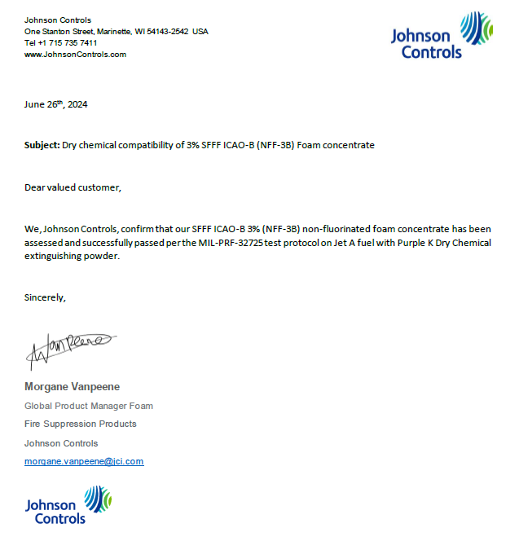
Dry Chemical Powder Compatibility
Powder / Foam Compatibility issues SFFFs vs AFFFs ?
JCI Compatibility testing confirmation
letter
Notes:
Our product has only just been launched so was not tested. JCI has carried out its own testing to the MIL Spec standard and confirm that it has passed per the MIL-PRF-32725 test protocol on Jet A fuels with Purple K powder.

Slide 19
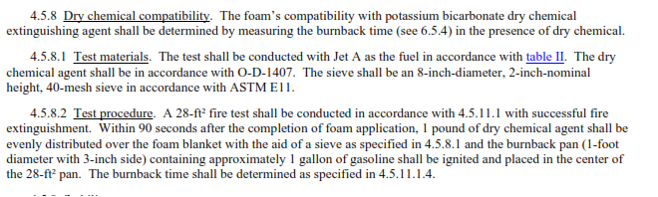
Dry Chemical Powder Compatibility
Powder / Foam Compatibility issues SFFFs vs AFFFs ?
JCI Compatibility testing confirmation
letter
Notes:
Above is the summary of the test, the materials used and the test procedure.

Slide 20
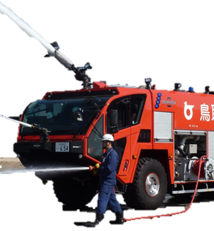
Foam Expansion
Roof Turret
Low Attack Bumper Turret
ARFFs are randomly using Air-Aspirated or Non-Air-Aspirated discharge devices based on Fire Truck manufacturers standards.
Handlines
NFFs do need minimum expansion to work ! We’ve pushed that message for the past 3 years
No requirement per ICAO standard to evaluate performance of Foams with non-air-aspirated equipment.
NFF-3B has been tested on ICAO standard using typical UNI-86 nozzle same as EN1568 giving high Low Expansion 9.5:1
Internal testing done on fire pan using 2.5 lpm/m² application rate successfully extinguishing using Expansion down to 4:1
NFF-3B is suitable for both Air-Aspirating or Non-Air-Aspirating discharge devices
Notes:
When we use our foam through the UNI-86 nozzle we achieved an expansion ratio of 9.5:1 with our foam, so competitor products than need to be used Aspirated only can get a pass with the UNI86 nozzle where they really should only be used Aspirated.
Concern is that this is not consistent with real life equipment such as a non-aspirating nozzle/monitor
This is the reason why we did our own test using a lower application rate at a lower expansion ration of 4:1
So what we have found with other independent testing such as the NRL/ Jensen Hughes report, allot of competitor foam product no longer work well through non-aspirated devices, the ICAO standard mandates testing only with Aspirated devices.

Slide 21
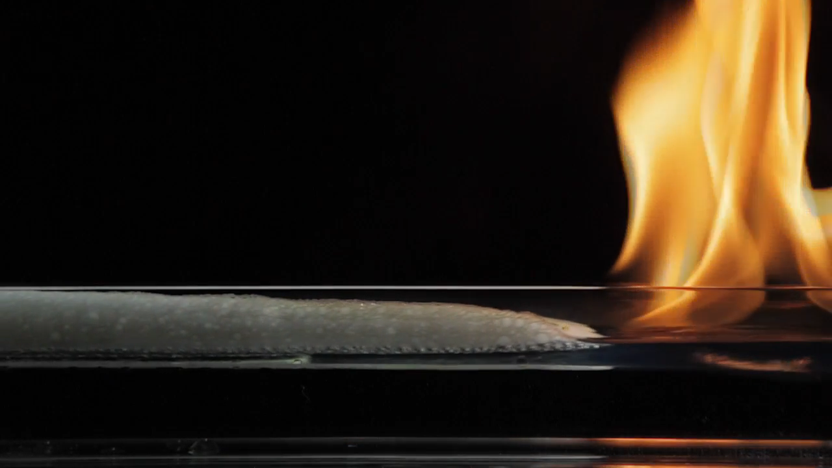

How Foam Works
Cools
Excludes Oxygen
Suppresses Vapors
Hydrocarbon Fuel
Aqueous Film
Notes:
Loss of the Aqueous film
Loss of oleophobic properties with their ability to shed fuel
AFFF has two mechanisms of extinction
The expanded foam blanket
The Aqueous film
With Non-Flurorinated foams we have removed the Aqueous Film, so the quality of the Expanded Foam is now critical for foam performance. Some manufactures have now found the need greater expansion to achieve the same performance

Slide 22
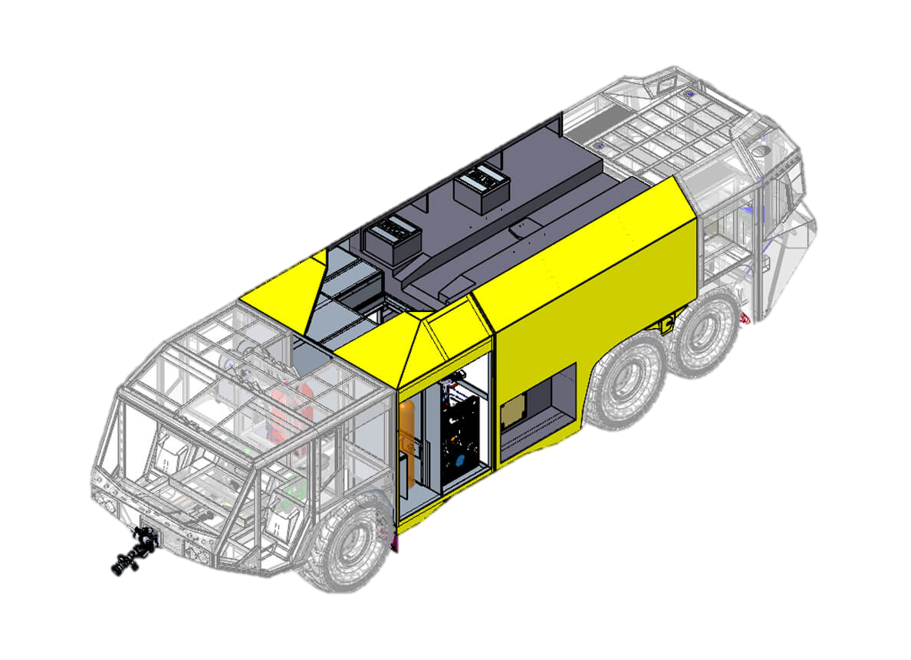
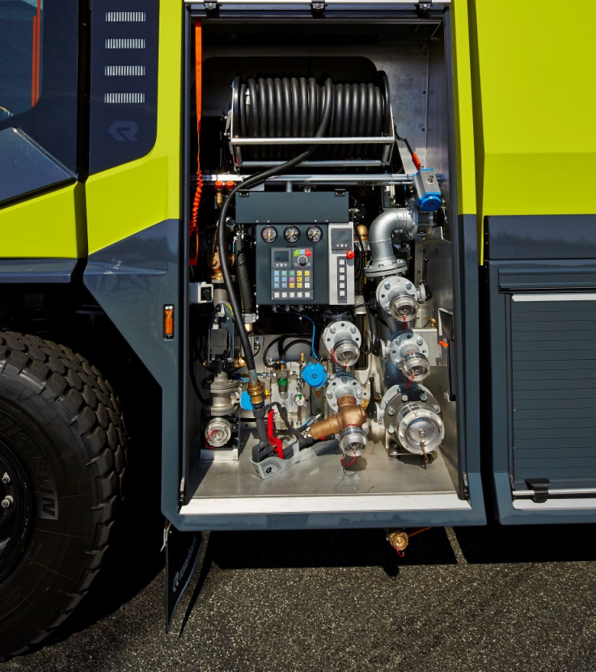
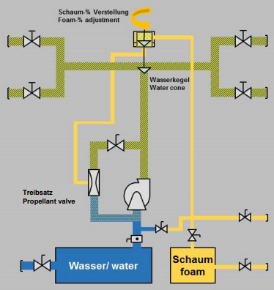

Foam Viscosity
ARFFs are mostly using Foam Pump proportioning systems, Around the pump or Electronic Dosing systems
Rosenbauer FIXMIX diagram example – Around the pump system
NFF-3B is a Newtonian foam and is a step-in product to ICAO AFFFs within ARFFs dosing systems. (Known cases of ARFF dosing systems struggling with too low viz products)
NFF-3B is a Newtonian Foam
NFF-3B viscosity data :
  4 cSt @ 20 °C (68 °F)
  8 cSt @ 0 °C (32 °F)

Slide 23
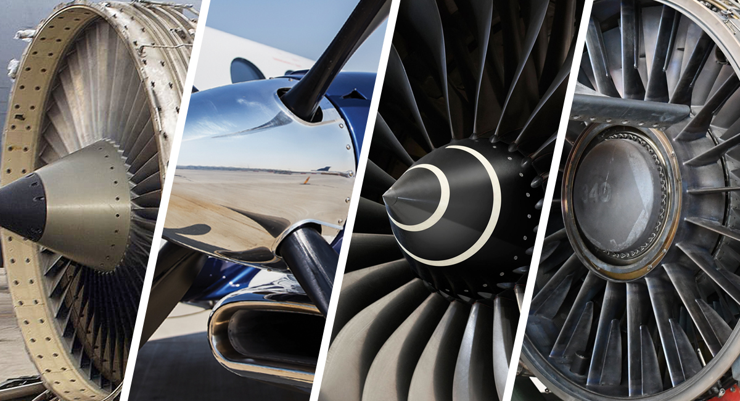
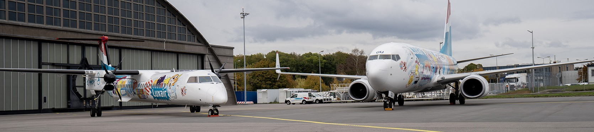
Engines
Fuel differences
Jet engines are using Kerosene or JET-A
Propeller engines are using Aviation Gasolines
Please consider several Aviation fuels type being used on an Airport either in safety design or fire response … not just Kerosene !

Slide 24




Greenscreen … a Label of interest
www.greenscreenchemicals.org
GreenScreen Certified™ is an independent, non-profit certification standard that promotes the use of PFAS-free and preferred chemicals in products and manufacturing.
GreenScreen Certified™ works to provide purchasers and firefighters with the assurance that PFAS-free* firefighting foam products are not regrettable substitutes by building on the widely recognized GreenScreen chemical scores to:
Require manufacturers to disclose all intentionally added chemicals and impurities in the products.
Require analytic testing to ensure products are PFAS-free.
Prohibit over 2,000 other chemicals of high concern.
Require products meet rigorous criteria and aquatic toxicity testing of the product in concentrate form to minimize potential harm to aquatic life.
Ensuring a firefighting foam product is PFAS-free is only the beginning. GreenScreen Certified™ Firefighting Foam also prohibits thousands of other chemicals of concern, including:
All organohalogens
Siloxanes (D4, D5, and D6)
ZDHC Manufacturing Restricted Substance List
Alkyl Phenols (APs) & Alkylphenol Ethoxylates (APEOs)
Over 2,000 other chemicals of high concern (CoHCs) identified as GreenScreen Benchmark1 or GreenScreen List Translator-1 because they are carcinogens, mutagens, reproductive or developmental toxicants (CMRs); persistent, bioaccumulative, and toxic chemicals (PBTs); very persistent and very bioaccumulative (vPvB); or equivalent concern such as endocrine disruptors.
Slide text content strictly from Greenscreen website
Notes:
Greenscreen is an independent, non-profit certification standard that promotes the use of PFAS-free and preferred chemicals in products and manufacturing.
To get the listing we as a manufacturer need to provide full disclosure of our product, the ingredients, including any impurities
It requires analytic testing to ensure products are PFAS free.
And it checks against 2000 other chemicals which are of high concern.
So being Greenscreen certified not only confirms the product is PFAS free but also checks against thousands of other chemicals of concern included these others listed

Slide 25



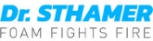





Competition Landscape ICAO-B 3% NFF foams
Large ICAO Level B SFFF 3% offering from competition
Key differentiation should be on:
Dry chem compatibility
Newtonian versus non-Newtonian
  Expansion - Non-Air Aspirating
  Greenscreen
  Drain Time = longer foam stability
 | NFF-3B | JETFOAM 3% | ECOPOL A3 | ECOPOL A3+ | VAPUREX LV ICAO B 3% F-10 | FFC ICAO 3% | RF3 | AVIGARD 3B | ENVIRO 3% ICAO | ENVIRO USP | ENVIRO AIR | ENVIRO ARF | SILVARA K3
 |  | AIRFOAM 3%
ICAO LEVEL @ 3% | B | B | B | B | B | B | B & C | B | B | B | B | B | B
NEWTONIAN VISCOSITY | Yes | Yes | Yes | Yes | Yes | Yes | No | Yes | No | No | Yes | Yes | Yes
VIZ DATA @ 20°C | 4 cSt | 2 cPs | 4 cSt @ 60 rpm | “Newtonian” | 20 mm²/s | no data | 5000-8000 cPs @ 30 rpm | < 30 mPas | ≤ 2000 mPas | 1500 mPas @ 60 rpm | 30 mPas | 20 mPas | ≤ 50 mPas @ 375 s-1
Drain time 25% [m:sec] | 6:10 | ≥ 3:00 | > 3:00 | > 3:00 | 2:00 - 4:00 | no data | no data | > 3:00 | 25:00 | 25:00 | 6:00 | 6:00 | ≥ 8:00
Drain time 50% [m:sec] | 12:30 | no data | no data | no data | 4:00 - 8:00 | no data | no data | no data | no data | no data | no data | no data | no data
Dry Chem compatibility | Yes | Yes | No | No | Yes ? | no data | No | No | No | No | Yes | Yes | No
Salt water compatibility | No | No | No | Yes | No | no data | Yes | Yes | No | No | No | No | No
Air Aspirated use | Yes | Yes | Yes | Yes | Yes | Yes | Yes | Yes | Yes | Yes | Yes | Yes | Yes
Non-Air Aspirated use | Yes | No | Yes* | Yes* | Yes* | no data | Yes | Yes* | ≥ 7:1 exp | ≥ 7:1 exp | No | No | No
Greenscreen | Yes - Pending | No | No | No | No | No | Yes | No | No | Yes | No | No | No
FREEZE PROTECTION | -2°C | 0°C | 0°C | -2°C | -10°C | -10°C | +2°C | -5°C | 0°C | 0°C | -15°C | -8°C | -5°C
ICAO Ext. time [m:sec] | 0:46 |  |  |  |  |  |  | 1:05
* statement in TDS as Compatible with "all" equipment
Key properties of differentiation
Rev 12 of Sthamer TDS does not mention anymore DCP compatibility !!!
F-5 #7344 version apparently available but no TDS on Sthamer website
Notes:
JCI Conversions In Italy Treviso and Verona airports

Slide 26
Summary / Value proposition
ICAO standard is a Pass / Fail test with no other specific side technical or performance requirements
and does not address…
- Dry chemical compatibility
- Expansion – Air and Non-Air Aspirating
- Newtonian versus non-Newtonian
- Drain Time = longer foam stability
- Greenscreen
Notes:
ICAO standard is a Pass / Fail test with no other specific side technical or performance requirements
and does not address…
- Dry chemical compatibility
- Expansion – Air and Non-Air Aspirating
- Newtonian versus non-Newtonian
- Drain Time = longer foam stability
- Greenscreen

Slide 27
Thank you
Q&A

